Slide 1

Event-Driven Malicious URL Extractor
2021-085
07.07.2021

Slide 2




Team Members
S. W Sajeth Jonathan
IT18071412
Team Leader
Wishvajith B.L.D.V​
IT18032666
Team Member
Ramanayaka A. M​
IT18021912
Team Member
Renu Harshatha A.
IT18034400
Team Member
07.07.2021

Slide 3
Introduction
07.07.2021

Slide 4
4.66 Billion
Internet Users
Jan 2021
https://datareportal.com/global-digital-overview
07.07.2021

Slide 5
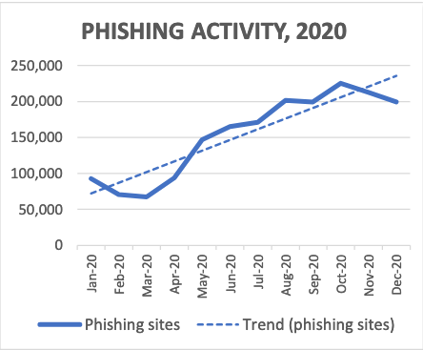
22% of data breaches involved Phishing*
APWG 2020 Q4 Report
*Verizon 2020 DBIR Report
07.07.2021

Slide 6
Research Problem
Event-driven System
Scalability
Finding URLs related to any global/local event for organizations to use as a blocklist
Adaptability of the system to change according to trending events.
07.07.2021

Slide 7
Research Problem
Classification Model
Feature Reduction
Machine Learning Models are used abundantly but sacrifices scalability and time as a trade-off
Identifying the correct features needed to build an efficient system
07.07.2021

Slide 8

Research Gap
Papers | Scalability | Accuracy | Classification of URLs | High rate of detection/efficiency | Ability to sort through keywords / Events | Classification of Scenarios
Research A [1]
Research B [2]
Research C [3]
Proposed Solution
10.03.2021
Notes:
[1] I. M. M. A. R. A. H. L. N. S. a. A. A. G. Mohammad Saiful, "Detecting Malicious URLs Using Lexical," in University of New Brunswick, Fredericton, NB, Canada, Fredericton, 2016.
[2] S. S. Vishal A. Kharde, "Sentiment Analysis of Twitter Data: A Survey of Techniques," International Journal of Computer Applications (0975 – 8887), vol. Volume 139, no. 11, p. 15, 2016.
[3] E. B. O. D. B. D. Ozgur Koray Sahingoz, "Machine learning based phishing detection from URLs," Expert Systems With Applications, 2019.

Slide 9
Research Objectives
Ensemble Model
Feature Reduction
01
02
Improve accuracy without decreasing performance
Reduce dimensionality of the extracted features
Event-driven System
Scalability
03
04
To detect attacks early in the life cycle
Scales the system when increase in URLs and keywords.
10.03.2021

Slide 10
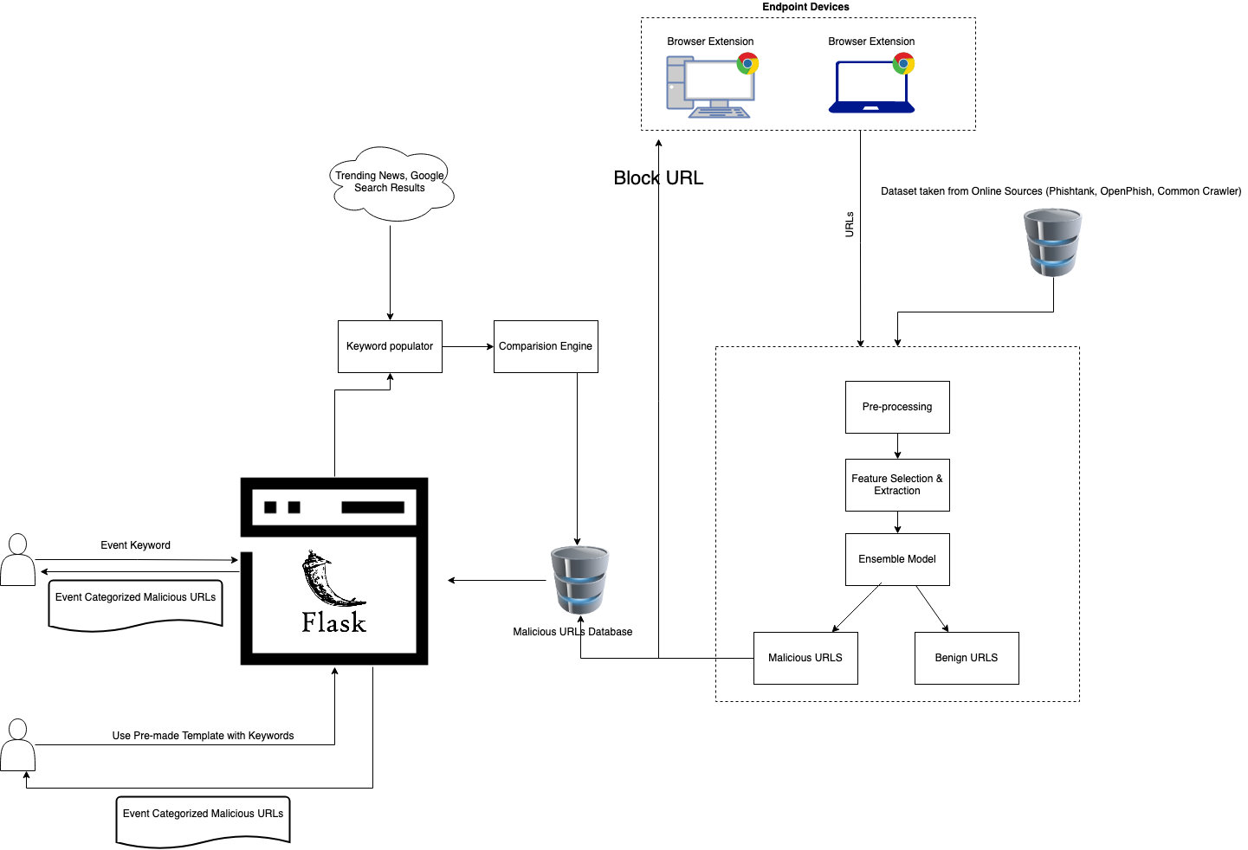
Overall System Diagram
10.03.2021

Slide 11
Our Contributions
07.07.2021

Slide 12
S. W Sajeth Jonathan IT18071412
IT18071412 | S.W Sajeth Jonathan | 2021-085 07.07.2021

Slide 13
Introduction
IT18071412 | S.W Sajeth Jonathan | 2021-085 07.07.2021

Slide 14
Background
Events Spawning Malicious URLS
Throughout the COVID-19 outbreak, malicious attacks have become more pervasive and damaging than ever. [3]
IT18071412 | S.W Sajeth Jonathan | 2021-085 07.07.2021
Notes:
Vijay Kotu, Bala Deshpande PhD, in Predictive Analytics and Data Mining, 2015 .3.4 Ensemble Modeling
Ensemble modeling is a process where multiple diverse models are created to predict an outcome, either by using many different modeling algorithms or using different training data sets.

Slide 15
Background
Phishing attack consists of 4 phases [1]
Attacker prepares the webpage
Victim is tempted to click the link
1
2
3
4
Delivers it to the masses
Victim is manipulated in disclosing credentials/ download malware
IT18071412 | S.W Sajeth Jonathan | 2021-085 07.07.2021

Slide 16
Background
Machine Learning
Deep Learning
Support Vector Machines (SVMs)
kNNs
Naïve Bayes
Logistic Regression
AdaBoost
Random Forest
Deep Neural Networks (DNNs) [4] Convolutional Neural Networks (CNNs) [4] Deep Belief Networks (DBNs) [5]
Long-Short Term Model (LSTM) [6]
Recurrent Neural Networks [7]
IT18071412 | S.W Sajeth Jonathan | 2021-085 07.07.2021

Slide 17
Background
Machine Learning
Ensemble modeling is a process where multiple diverse models are created to predict an outcome, either by using many different modeling algorithms or using different training data sets.
Recurrent Neural Networks (RNNs) + Convolutional Neural Networks (CNNs) [7]
Artificial Neural Network (ANN) + K-Nearest Neighbors (KNN) + Decision Tree (C4.5) + Random Forest Classifier (RFC) [10]
Long-Short Term Memory [LSTM] + Convolutional Neural Networks (CNNs) [7]
Monotone Multi-Layer Perceptron Neural Network, Multi-Layer Perceptron, Neural Networks [9]
IT18071412 | S.W Sajeth Jonathan | 2021-085 10.03.2021
Notes:
Vijay Kotu, Bala Deshpande PhD, in Predictive Analytics and Data Mining, 2015 .3.4 Ensemble Modeling
Ensemble modeling is a process where multiple diverse models are created to predict an outcome, either by using many different modeling algorithms or using different training data sets.

Slide 18
Research Question
Which ensemble model will give adequate accuracy without trading too much in perfomance?
How to collect training and testing data effectively?
How to make the user interface intuitive to collect Event-based Malicious URLs ?
IT18071412 | S.W Sajeth Jonathan | 2021-085 07.07.2021

Slide 19
Objectives
Main Objective
Experiment and test combinations of various ML/DL models to find an effective ensemble model
Bidirectional LSTM + CNN [7]
IT18071412 | S.W Sajeth Jonathan | 2021-085 07.07.2021

Slide 20
Objectives
Sub Objectives
Build the webite using Python Flask Framework to collect event-based phishing URLs to detect malicious links early in the attack lifecycle
Provide Visualization to Viewers
Export Event-based databases in CSV Format
IT18071412 | S.W Sajeth Jonathan | 2021-085 07.07.2021

Slide 21
Objectives
Sub Objectives
Collect Training and Testing data from publicly available sources
OpenPhish
PhishTank
Common Crawler
Alexa
IT18071412 | S.W Sajeth Jonathan | 2021-085 10.03.2021

Slide 22
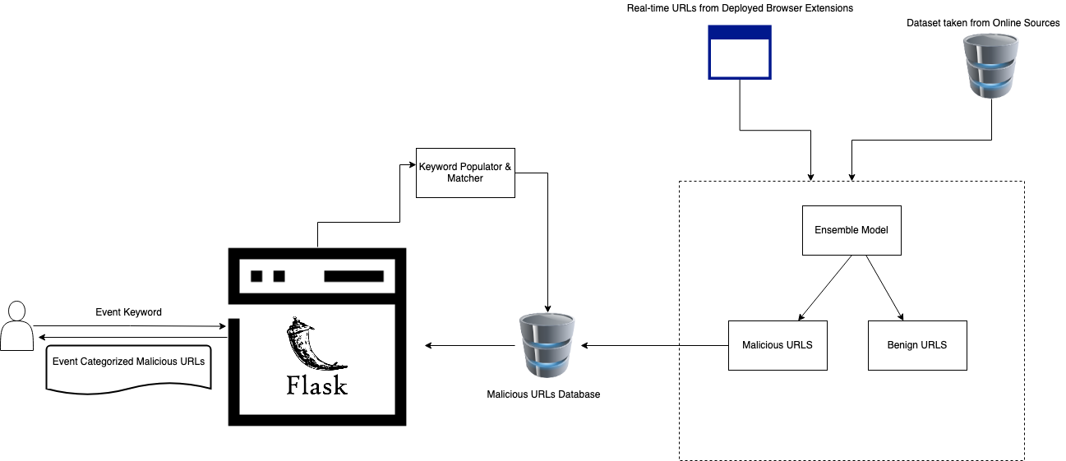
System Diagram
IT18071412 | S.W Sajeth Jonathan | 2021-085 10.03.2021

Slide 23
Completion of the Project
Approaches to achieving the sub objective

Slide 24
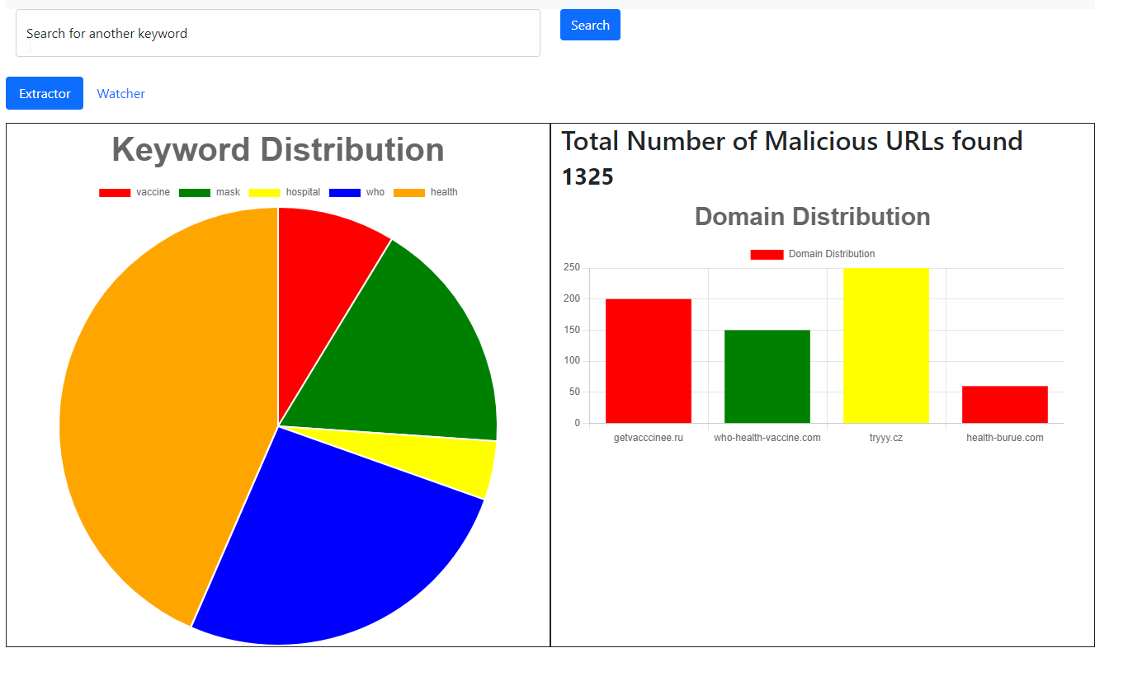
Visualizer – Sub Objective 01
Simple UI
Lets the user know the keywords related to the topic they were searching
Provided stats on the distribution of these keywords within different domains
IT18071412 | S.W Sajeth Jonathan | 2021-085 10.03.2021

Slide 25
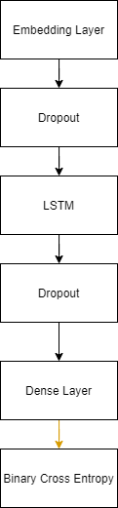
Classifier
Ensemble
LSTM
CNN
IT18071412 | S.W Sajeth Jonathan | 2021-085 10.03.2021

Slide 26
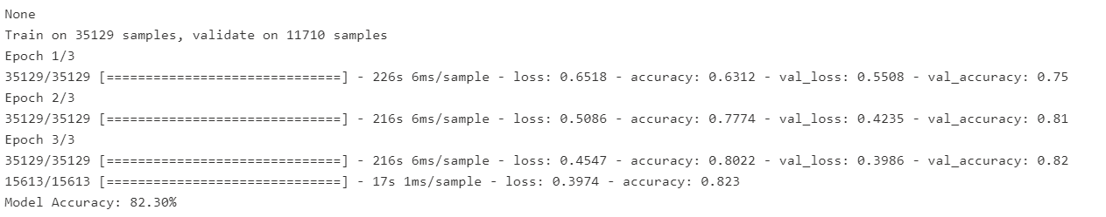
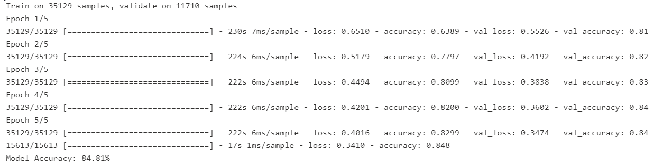
LSTM
3 Epoch
5 Epoch
IT18071412 | S.W Sajeth Jonathan | 2021-085 10.03.2021

Slide 27
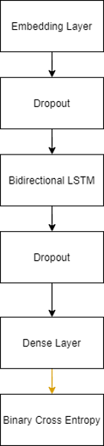

Classifier
Ensemble
Bidirectional- LSTM
CNN
IT18071412 | S.W Sajeth Jonathan | 2021-085 10.03.2021

Slide 28
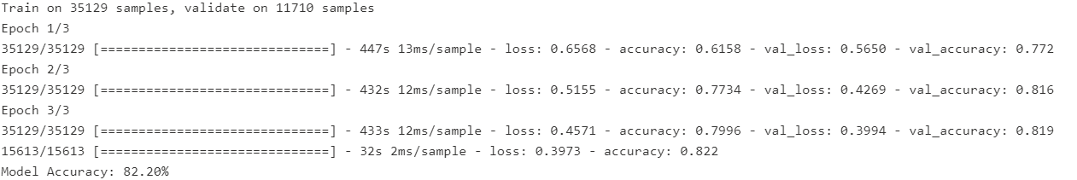
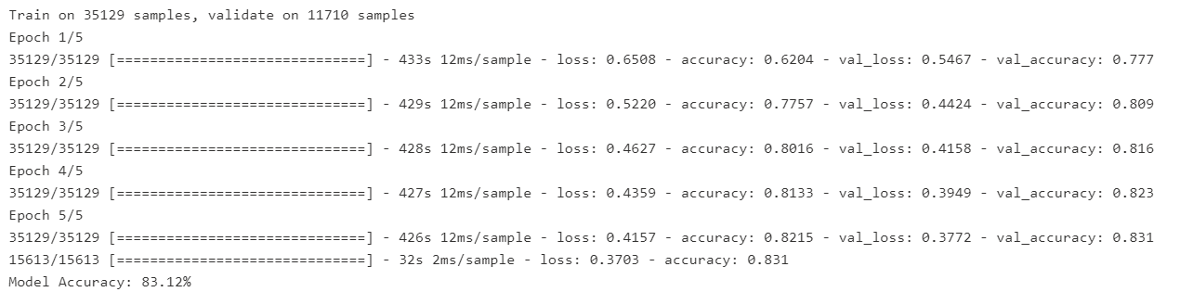
Bidirectional LSTM
3 Epoch
5 Epoch
IT18071412 | S.W Sajeth Jonathan | 2021-085 10.03.2021

Slide 29

Approaches to achieving objective
Compared LSTM models with Bi-direcional Models
Did initial testing with RFCs and DTs
Built the UI using Chart.js
55%
IT18071412 | S.W Sajeth Jonathan | 2021-085 10.03.2021

Slide 30
Future Implmentations
Build the back-end system using Flask to handle authentication and provie JSON outptuts
Run the classification model up to 50/100 epoch and compare output
Add a CNN model to complete the ensemble modeling process
35%
IT18071412 | S.W Sajeth Jonathan | 2021-085 10.03.2021

Slide 31
References
​[1] S. N. P. N.Badadhe, "An Efficient Approach To Detecting Phishing A Web Using K-Means And Naïve-Bayes Algorithms With Results.," International Journal of Advanced Research in Computer Engineering & Technology (IJARCET, vol. 3, no. 5, p. 1, 2014.
​[2] R. K. S. B. a. S. S. F. Sadique, "An Automated Framework for Real-time Phishing URL Detection," in 10th Annual Computing and Communication Workshop and Conference (CCWC), Las Vegas, NV, USA, 2020.
[3] ​"APWG Trend Report," 2020. [Online]. Available: https://docs.apwg.org/reports/apwg_trends_report_q4_2020.pdf. [Accessed 25 February 2020].
​[4] W. F. S. S.-G. M. S. E. Benavides, "Classification of Phishing Attack Solutions by Employing Deep Learning Techniques: A Systematic Literature Review," Research Gate, 2020.
​[5]Y. F. Z. Y. Y. W. W. T. Z. P. Yi, "Web Phishing Detection Using a Deep Learning Framework," Wireless Communications and Mobile Computing, vol. 2018, 2018.

Slide 32
Wishvajith B.L.D.V. IT18032666
07.07.2021

Slide 33
Research Questions
How to populate related keywords from the event given by the user?
How to match the populated keywords with the malicious URLs database?
IT18032666 | Wishvajith B.L.D.V. | 2021-085 07.07.2021
Notes:
Vijay Kotu, Bala Deshpande PhD, in Predictive Analytics and Data Mining, 2015 .3.4 Ensemble Modeling
Ensemble modeling is a process where multiple diverse models are created to predict an outcome, either by using many different modeling algorithms or using different training data sets.

Slide 34
Specific and Sub Objectives
Main Objective
• Make use of user inputted keywords and match them with current trends/events to aid with identifying potential malicious URLs.
In order to achieve this,
1.Identify an efficient strategy to populate keywords from user inputs.
2.Build a model to find related keywords for an event by aggregating with online sources.
3. Co-relate the populated keyword tokens with the phishing URLs database.
IT18032666 | Wishvajith B.L.D.V. | 2021-085 07.07.2021
Notes:
Vijay Kotu, Bala Deshpande PhD, in Predictive Analytics and Data Mining, 2015 .3.4 Ensemble Modeling
Ensemble modeling is a process where multiple diverse models are created to predict an outcome, either by using many different modeling algorithms or using different training data sets.

Slide 35
Methodology
IT18032666 | Wishvajith B.L.D.V. | 2021-085 10.03.2021

Slide 36
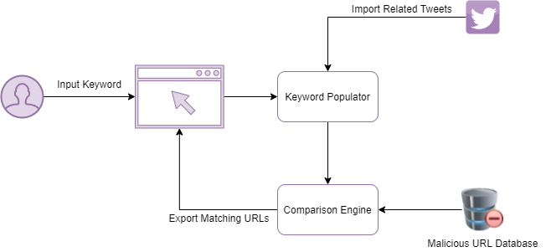
System Diagram
IT18032666 | Wishvajith B.L.D.V. | 2021-085 07.07.2021
Notes:
http://cs229.stanford.edu/proj2012/ChongLiu-MaliciousURLDetection.pdf [2]
https://arxiv.org/pdf/1009.2275v1.pdf [3]
https://escholarship.org/uc/item/4q3611mk#figure.caption.56 [4]

Slide 37
Methodology
Populating Keywords
Keyword Populator
• User inputs a keyword using the interface. (ex : Covid, Tsunami)
IT18032666 | Wishvajith B.L.D.V. | 2021-085 07.07.2021

Slide 38
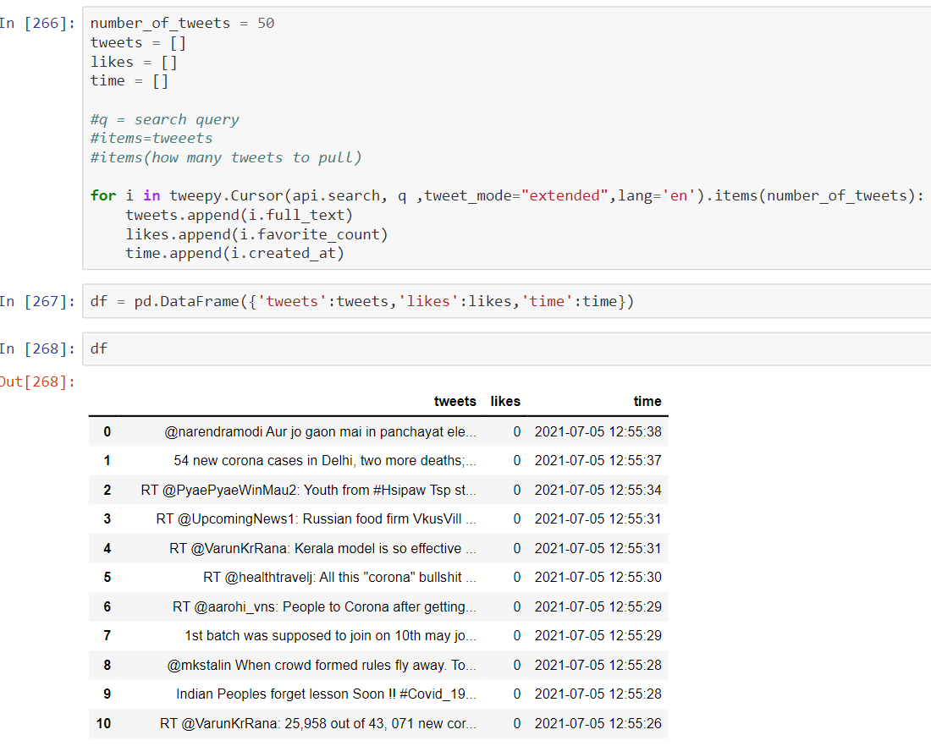
Methodology
Populating Keywords - Keyword Populator
• Keyword populator will use the Twitter API to find related, real-time tweets from Twitter.
• Import the keywords to a data frame.
IT18032666 | Wishvajith B.L.D.V. | 2021-085 07.07.2021

Slide 39
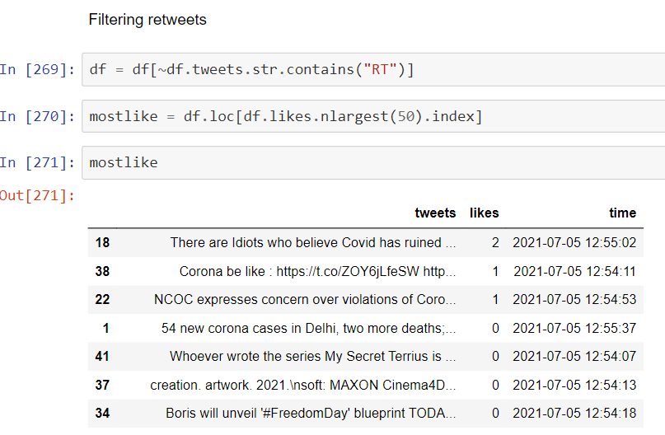
Methodology
• Imported tweets are filtered to remove Re-tweets.
Populating Keywords - Keyword Populator
IT18032666 | Wishvajith B.L.D.V. | 2021-085 07.07.2021

Slide 40
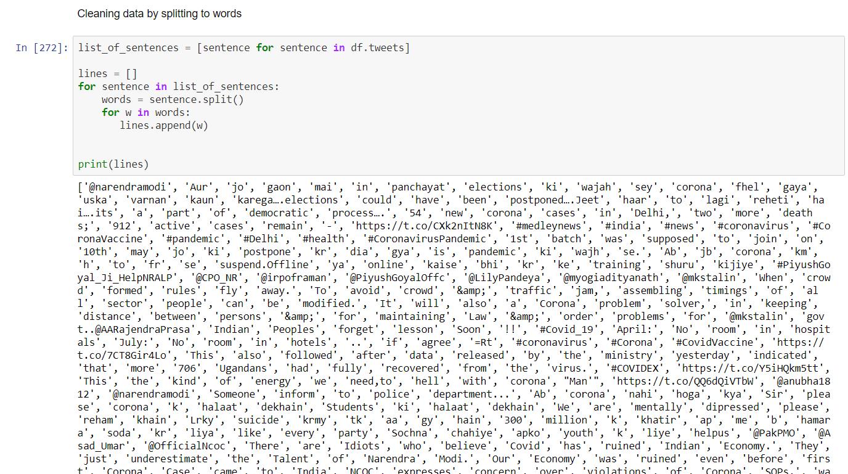
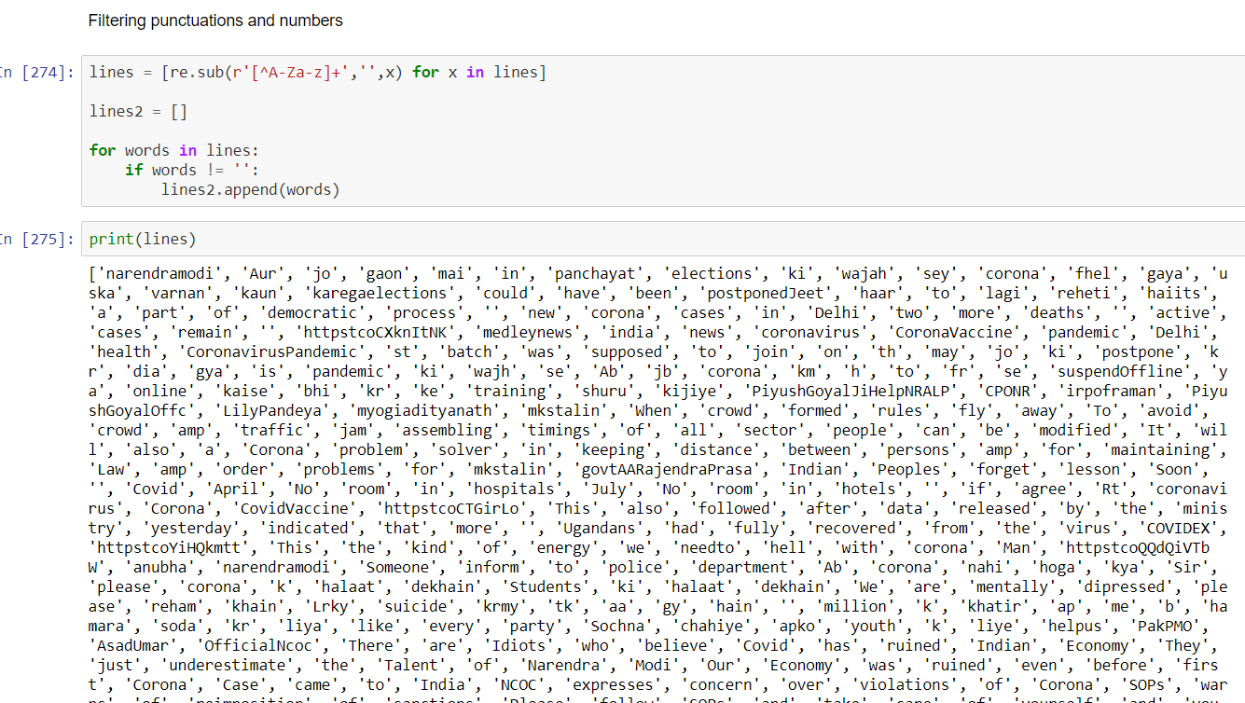
Methodology
Populating Keywords - Keyword Populator
• Tweets are separated into words for cleaning.
IT18032666 | Wishvajith B.L.D.V. | 2021-085 07.07.2021

Slide 41
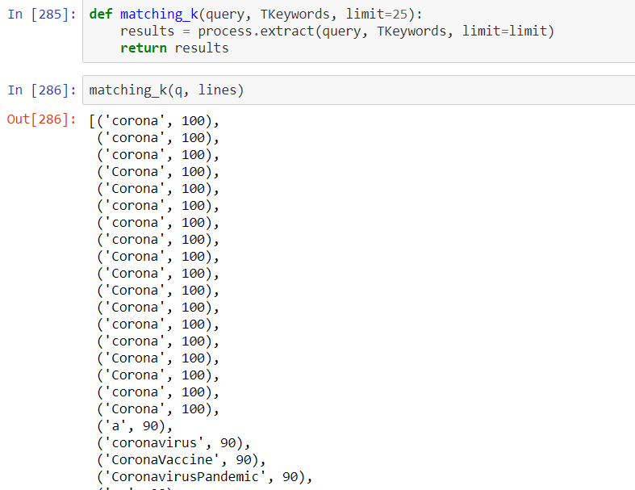
Methodology
Populating Keywords - Keyword Populator
• Generated keywords are matched with the input query to find meaningful keywords.
IT18032666 | Wishvajith B.L.D.V. | 2021-085 07.07.2021

Slide 42
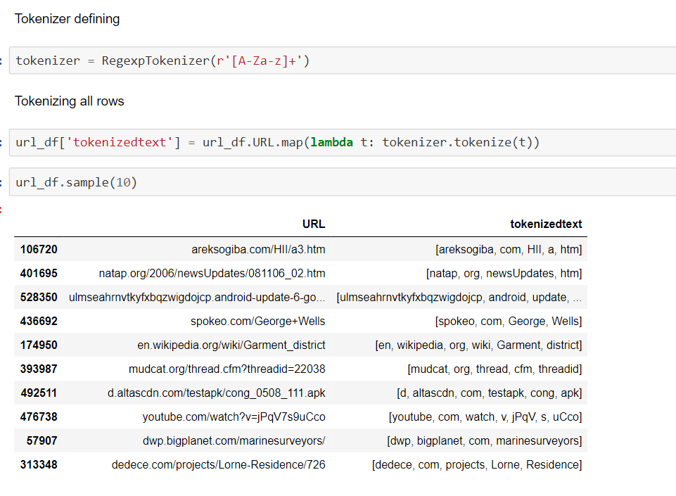
Methodology
Comparison Engine
• Import the malicious URL links from classified URLs in database.
Dataset - phishing-site-urls
• Tokenize the URLs using Regexp Tokenizer.
IT18032666 | Wishvajith B.L.D.V. | 2021-085 07.07.2021
Notes:
http://cs229.stanford.edu/proj2012/ChongLiu-MaliciousURLDetection.pdf [2]
https://arxiv.org/pdf/1009.2275v1.pdf [3]
https://escholarship.org/uc/item/4q3611mk#figure.caption.56 [4]

Slide 43
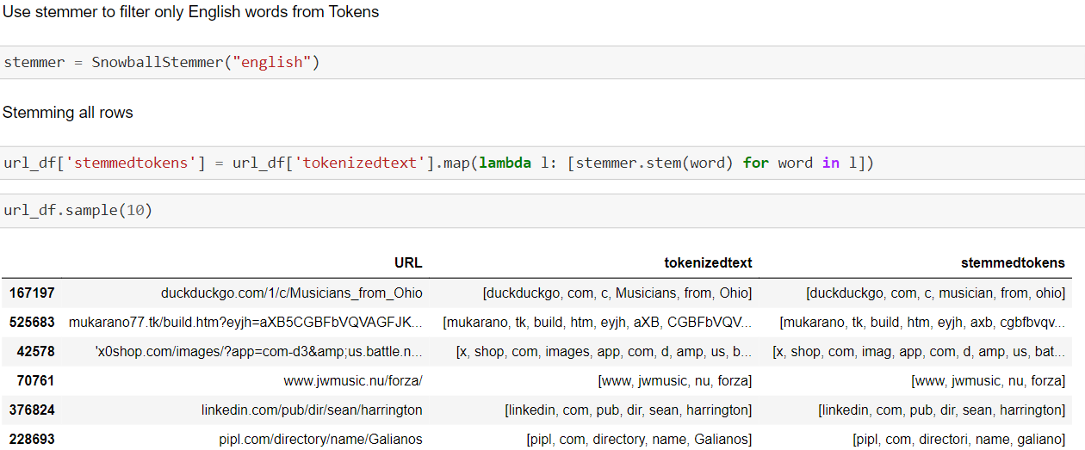
Methodology
Comparison Engine
• Stem the tokenized words/phrases.
IT18032666 | Wishvajith B.L.D.V. | 2021-085 07.07.2021
Notes:
http://cs229.stanford.edu/proj2012/ChongLiu-MaliciousURLDetection.pdf [2]
https://arxiv.org/pdf/1009.2275v1.pdf [3]
https://escholarship.org/uc/item/4q3611mk#figure.caption.56 [4]

Slide 44
Methodology
Comparison Engine
• Match the tokenized keywords against the keywords from populator module.
• Export the matching URLs.
IT18032666 | Wishvajith B.L.D.V. | 2021-085 07.07.2021
Notes:
http://cs229.stanford.edu/proj2012/ChongLiu-MaliciousURLDetection.pdf [2]
https://arxiv.org/pdf/1009.2275v1.pdf [3]
https://escholarship.org/uc/item/4q3611mk#figure.caption.56 [4]

Slide 45





Technologies / Tools and Libraries Used
IT18034400 | Renu Harshatha A. | 2021-085 10.03.2021

Slide 46
Completion of the Project
IT18032666 | Wishvajith B.L.D.V. | 2021-085 07.07.2021

Slide 47
Keyword Populator
Completed | To do / Improve
Experiment with methods to find a suitable method for finding keywords related to user input | Improve the quality of the keywords
Find URL dataset for testing
Wrote a script to collect tweets related to user input using Twitter API
Generation of keywords from the tweets
Test the model for various inputs
IT18032666 | Wishvajith B.L.D.V. | 2021-085 07.07.2021
Notes:
http://cs229.stanford.edu/proj2012/ChongLiu-MaliciousURLDetection.pdf [2]
https://arxiv.org/pdf/1009.2275v1.pdf [3]
https://escholarship.org/uc/item/4q3611mk#figure.caption.56 [4]

Slide 48
Comparison Engine
Completed | To do / Improve
Find URL dataset for testing | Improve the quality of the keyword tokens
Train the model with dataset | Mapping keywords from populator with keyword tokens
Generating keyword tokens from URLs.
Cleaning the generated keywords
IT18032666 | Wishvajith B.L.D.V. | 2021-085 07.07.2021
Notes:
http://cs229.stanford.edu/proj2012/ChongLiu-MaliciousURLDetection.pdf [2]
https://arxiv.org/pdf/1009.2275v1.pdf [3]
https://escholarship.org/uc/item/4q3611mk#figure.caption.56 [4]

Slide 49
Ramanayaka A. M IT18021912
IT18021912 | Ramanayaka A. M | 2021-085 07.07.2021

Slide 50
Research Objectives
Ensemble Model
Feature Reduction
01
02
Improve accuracy without decreasing performance
Reduce dimensionality of the extracted features
Event-driven System
Scalability
03
04
To detect attacks early in the life cycle
Scales the system when increase in URLs and keywords.
07.07.2021

Slide 51
Research Objective
How can the feature reduction be done to build an ensemble model that will be efficient enough to detect phishing URLs with better scalability and speed?
IT18021912 | Ramanayaka A. M | 2021-085 07.07.2021

Slide 52
Objectives
IT18021912 | Ramanayaka A. M | 2021-085 07.07.2021

Slide 53
Feature Reduction
Feature Classification
Feature Extraction
Feature Analysis
Feature Reduction
IT18021912 | Ramanayaka A. M | 2021-085 07.07.2021

Slide 54
Methodology
IT18021912 | Ramanayaka A. M | 2021-085 07.07.2021

Slide 55
Feature Extraction
IT18021912 | Ramanayaka A. M | 2021-085 07.07.2021

Slide 56
Feature Extraction Process
Feature Classification will be done as shown below:
Address Bar based Features
Domain based Features
HTML & JavaScript based features
IT18021912 | Ramanayaka A. M | 2021-085 07.07.2021

Slide 57
Address Bar based Features
Domain of URL
IP Address in URL
Presence of “@” symbol in URL
Length of URL
Depth of URL
Redirection “//” in URL
“http/https” in Domain name
Use of URL Shortening Services “Tiny URL”
Prefix/Suffix ‘-’ in Domain
IT18021912 | Ramanayaka A. M | 2021-085 07.07.2021

Slide 58
Domain based Features
DNS Record
Website Traffic
Age of Domain
End Period of Domain
IT18021912 | Ramanayaka A. M | 2021-085 07.07.2021

Slide 59
HTML and JavaScript based Features
iFrame Redirection
Status Bar Customization
Disabling Right Click
Website Forwarding
IT18021912 | Ramanayaka A. M | 2021-085 07.07.2021

Slide 60
Process
Loading data sets
Malicious URL data set from Phishtank
http://data.phishtank.com/data/online-valid.csv
Legitimate URL data set from UNB
https://www.unb.ca/cic/datasets/url-2016.html
Datasets will be downloaded and the URLs in them will be checked for the previously mentioned features and then will be extracted
IT18021912 | Ramanayaka A. M | 2021-085 07.07.2021

Slide 61
Process -Continued..
URLs would be randomly chosen from both data sets.
Feature extraction would be done on them
The list would be converted to a dataframe
Two lists which are legitimate and malicious URLs, after the feature extraction, will be made
They will then be concatenated and exported as a separate .csv file for feature analysis.
IT18021912 | Ramanayaka A. M | 2021-085 07.07.2021

Slide 62
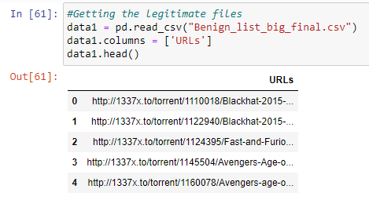
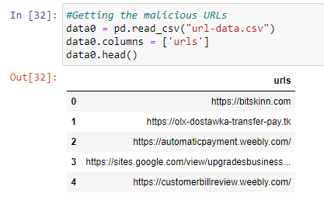
IT18021912 | Ramanayaka A. M | 2021-085 07.07.2021

Slide 63
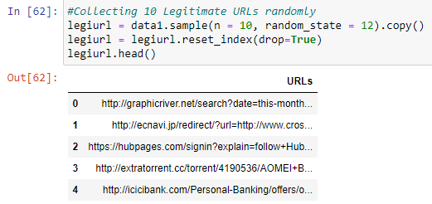
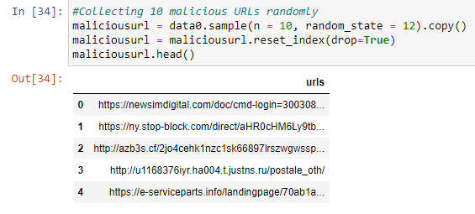
IT18021912 | Ramanayaka A. M | 2021-085 07.07.2021

Slide 64
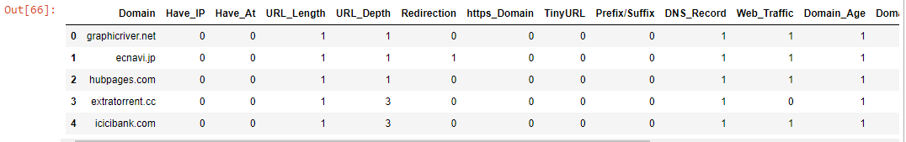
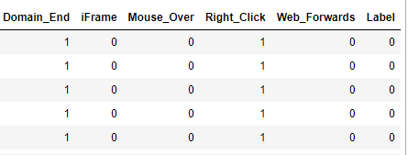
Storing features of legitimate URLs in a data frame
IT18021912 | Ramanayaka A. M | 2021-085 07.07.2021

Slide 65
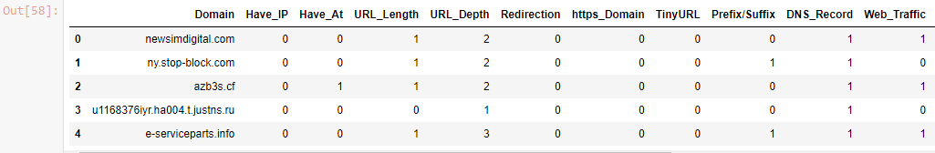
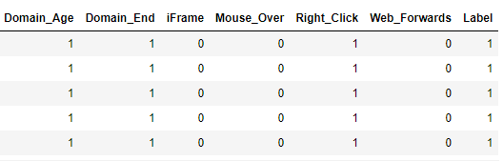
Storing features of malicious URLs in a data frame
IT18021912 | Ramanayaka A. M | 2021-085 07.07.2021

Slide 66
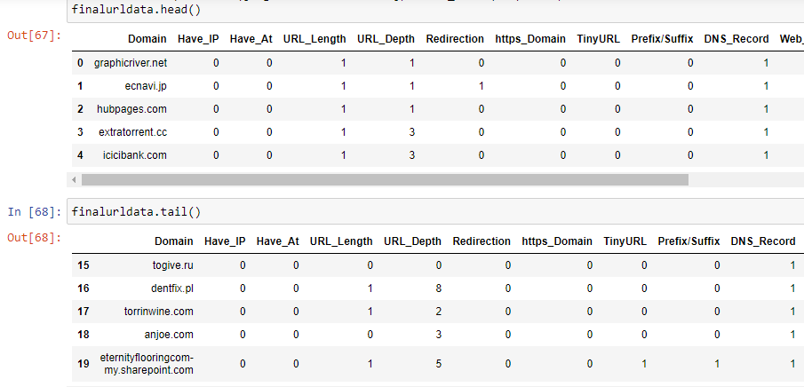
Concatenated data that was stored in a .csv file
IT18021912 | Ramanayaka A. M | 2021-085 07.07.2021

Slide 67
Feature Analysis
IT18021912 | Ramanayaka A. M | 2021-085 07.07.2021

Slide 68
Feature Analysis Process
The previous dataset which was created in feature extraction will be used for this process.
It will be loaded in to a data-frame.
It will be checked for NaN values and rows will be removed.
Then we will get a total of how features were listed for the URL to see which features are the most common
IT18021912 | Ramanayaka A. M | 2021-085 07.07.2021

Slide 69
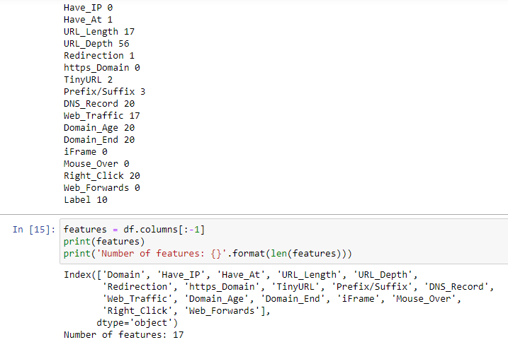
IT18021912 | Ramanayaka A. M | 2021-085 07.07.2021

Slide 70
Renu Harshatha A. IT18034400
IT18034400 | Renu Harshatha A. | 2021-085 10.03.2021

Slide 71
Introduction
IT18034400 | Renu Harshatha A. | 2021-085 10.03.2021

Slide 72
Background
From January to April 2020, some 907,000 spam messages, 737 incidents related to malware and 48,000 malicious URLs - all related to Covid-19 were detected [5]
A campaign targeting businesses could see cybercriminals sending out documents that are made to look like government advice on dealing with Brexit which in fact download malware.[7]
As of April 2020, roughly 60,000 include COVID-19 related malicious attachments or malicious URLs. [6]
IT18034400 | Renu Harshatha A. | 2021-085 10.03.2021
Notes:
https://www.rte.ie/news/newslens/2020/0804/1157249-cybercrime/ [5]
https://www.microsoft.com/security/blog/2020/04/08/microsoft-shares-new-threat-intelligence-security-guidance-during-global-crisis/ [6]
https://www.itpro.co.uk/security/32560/spike-in-brexit-themed-phishing-attacks-expected-once-withdrawal-agreement-is [7]

Slide 73
Research Gap
Papers | Scalability | Accuracy | Classification of URLs | High rate of detection/efficiency | Ability to sort through keywords / Events | Classification of Scenarios
Research A [2]
Research B [3]
Research C [4]
Proposed Solution
IT18034400 Renu Harshatha A.. | 2021-085 10.03.2021

Slide 74

Background
Although there are systems to detect the malicious URLs, most of the researches’ primary focus is accuracy.
Increase in cyber-attacks
IT18034400 | Renu Harshatha A. | 2021-085 10.03.2021

Slide 75
Research Questions
How is our system going scale when there is more URLs to scan?
How is the system going to adapt when there’s more keywords?
IT18034400 | Renu Harshatha A. | 2021-085 10.03.2021

Slide 76
Specific and Sub Objectives
Main Objective:
Integrate Nomad to scale the proposed system.
Create a browser extension
Sub Objectives:
Containerize the proposed solution
Analyse cost on deploying the infrastructure
IT18034400 | Renu Harshatha A. | 2021-085 10.03.2021

Slide 77



Technologies/ Techniques
IT18034400 | Renu Harshatha A. | 2021-085 10.03.2021

Slide 78
System, Personnel & Software Requirements
Functional Requirements
The system shall collect URL data and warn the user when detect as malicious
Non Functional Requirements
Scalability
Accuracy & Efficiency

Slide 79
Work Breakdown Structure WBS
Event-Driven Malicious Extractor
Initiation
Planning
Design
Implementation
Closeout
Creation of Project Charter
Creation of Project Proposal
Choosing a methodology for scaling the system
Creating a browser extension
Setting up cloud
Wireframes , UI for browser extension
Testing Nomad containerisation with ensemble model
Testing the model’s scalability and accuracy
Testing and Implementing browser extension which also supports mobile devices
Implementing a procedure to Create logs and reports through browser extension
Host the application and run it
Final Presentation
System Design for Scaling the system
IT18034400 | Renu Harshatha A. | 2021-085 10.03.2021

Slide 80
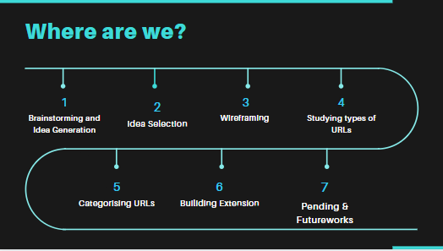
IT18034400 | Renu Harshatha A. | 2021-085 07.07..2021

Slide 81
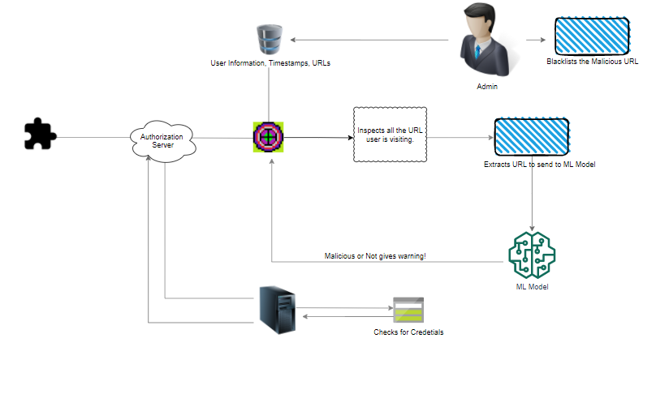
IT18034400 | Renu Harshatha A. | 2021-085 07.07..2021

Slide 82
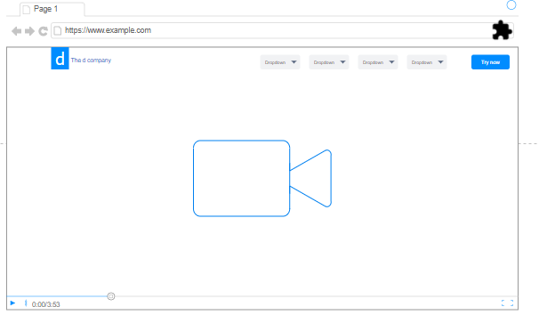
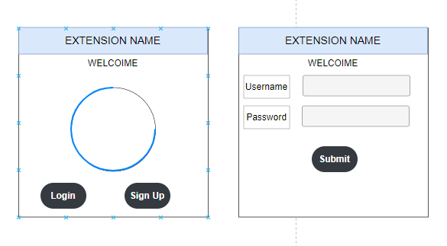
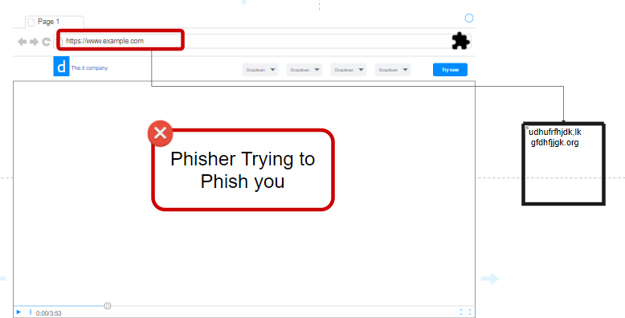
IT18034400 | Renu Harshatha A. | 2021-085 07.07..2021

Slide 83
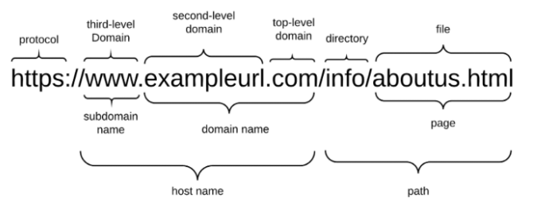
URLs
IT18034400 | Renu Harshatha A. | 2021-085 07.07..2021

Slide 84
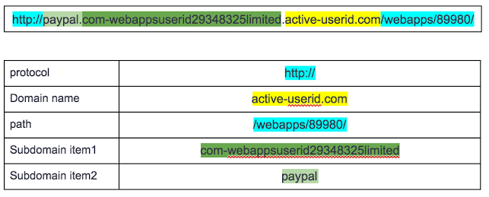
URLs
IT18034400 | Renu Harshatha A. | 2021-085 07.07..2021

Slide 85
Other ways cybercriminals use
Cybersquatting
Typosquatting
Features Used for Phishing Domain Detection
URL-Based Features
Domain-Based Features
Page-Based Features
Content-Based Features
IT18034400 | Renu Harshatha A. | 2021-085 07.07..2021

Slide 86

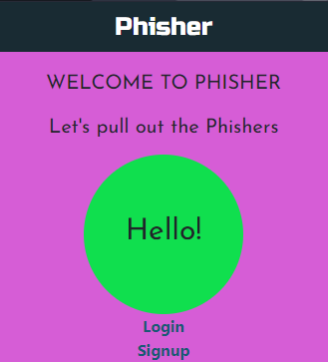
Extension
Secure The Need
IT18034400 | Renu Harshatha A. | 2021-085 07.07..2021

Slide 87
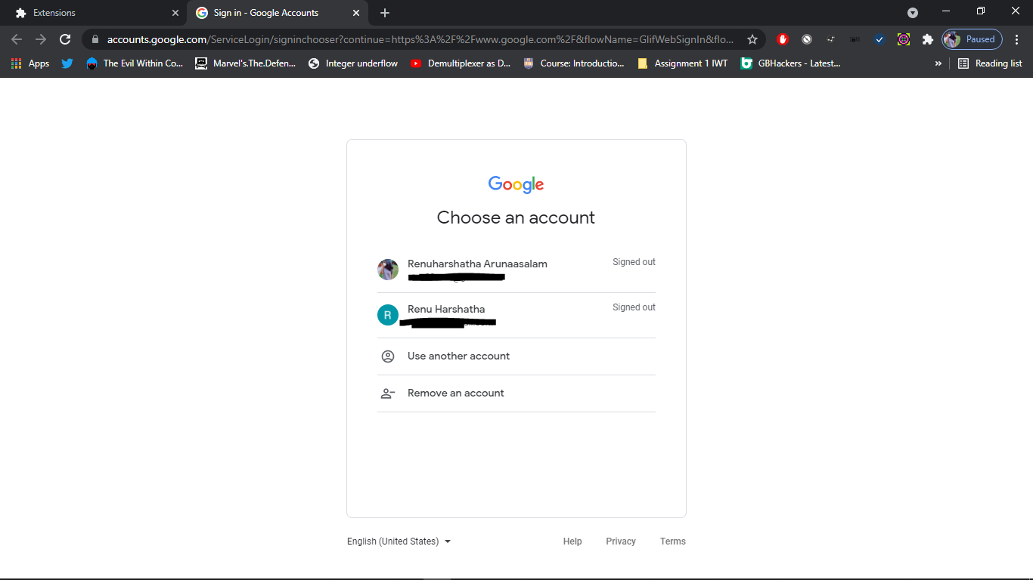
Extension
IT18034400 | Renu Harshatha A. | 2021-085 07.07..2021

Slide 88
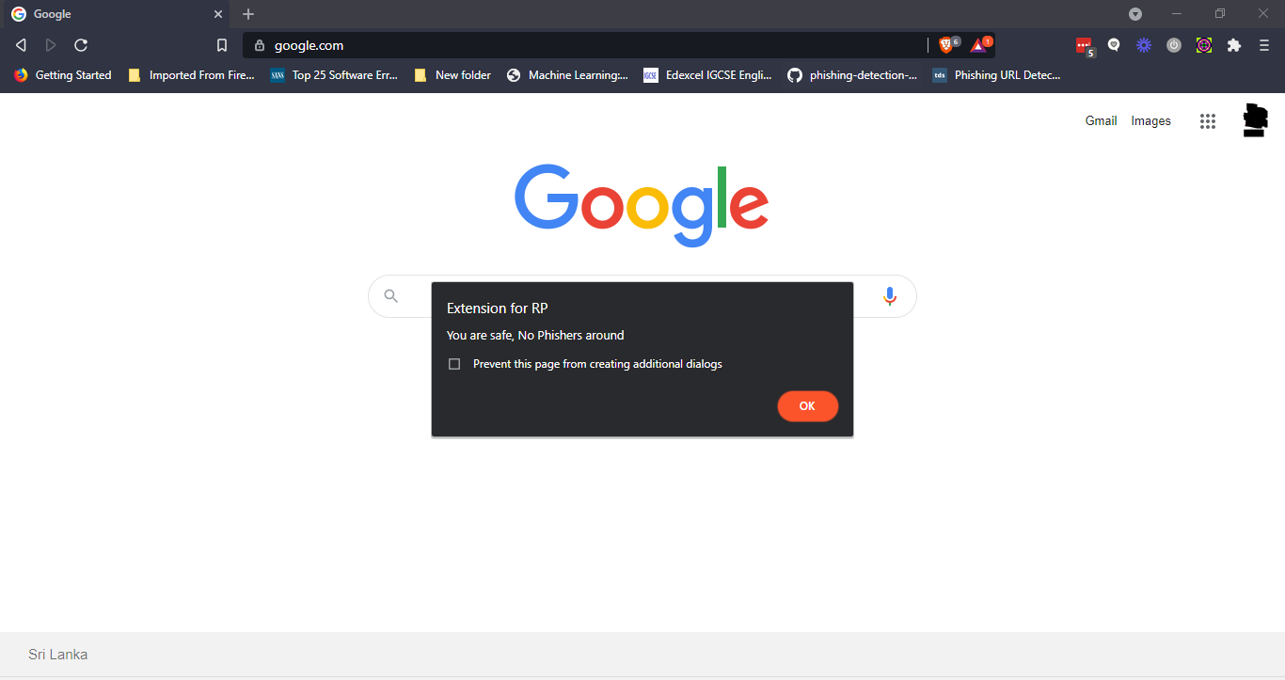
Extension
IT18034400 | Renu Harshatha A. | 2021-085 07.07..2021

Slide 89
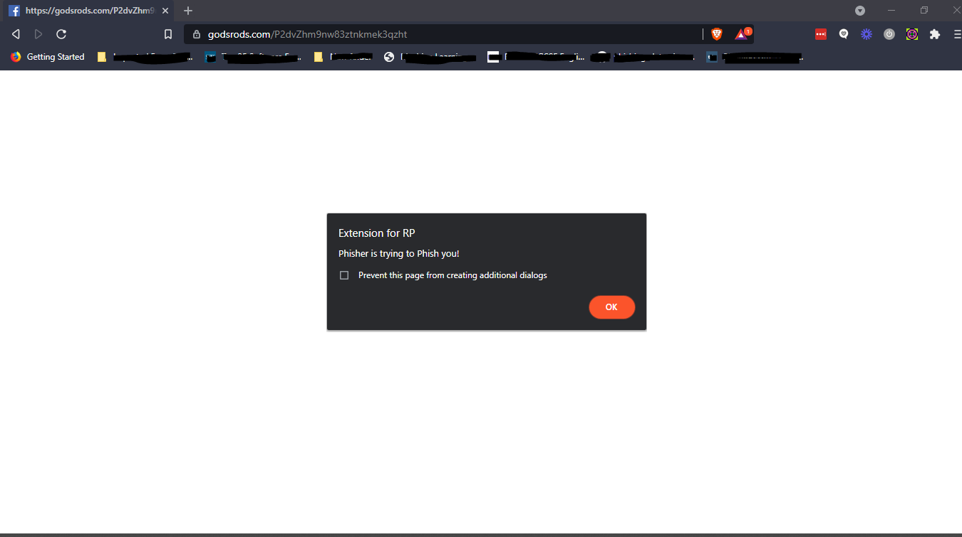
Extension
IT18034400 | Renu Harshatha A. | 2021-085 07.07..2021

Slide 90

So far progress & challenges?
Prepare storing URLs in JSON using javascript.
How can automate blacklisting the extracted URLs
Make the Extension more user friendly
60%
Focus on Scalability
Install Nomad, Integrate it with the ML model chosen
Improve Scalability of the extension and the overall system
Make website watcher, which generates report to admin.
IT18034400 | Renu Harshatha A. | 2021-085 07.07..2021

Slide 91
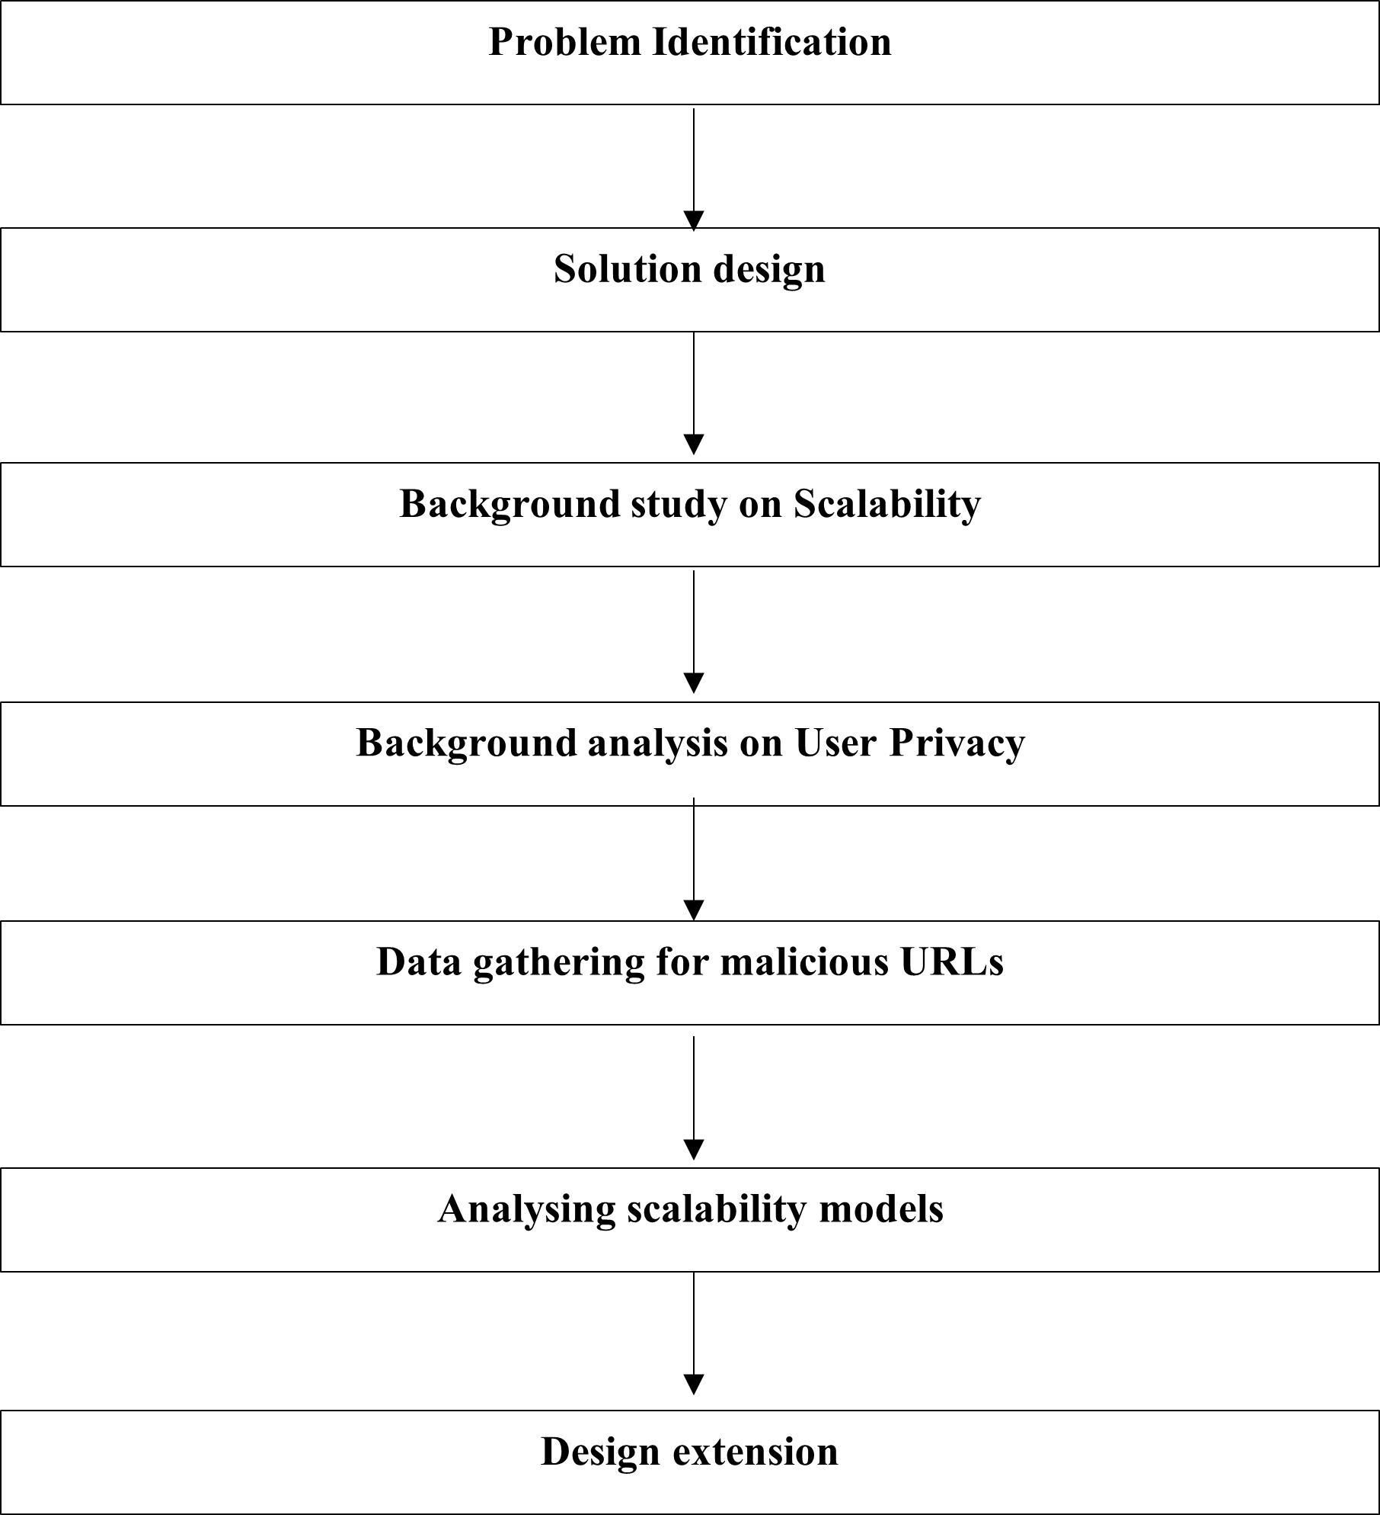

Slide 92
Scalability
Amount of data is huge thus; Scalability of ML models gets our attention.
Our model needs to deal with any amount of data with less consumption of resources
Machine Learning workflow can be categorised in to 2 primary routines
Model Training
Model Prediction
IT18034400 | Renu Harshatha A. | 2021-085 10.03.2021

Slide 93
Identifying critical dimensions in ML
What are the problem that can be caused due to lack of scalability?
- Training dataset is too large
- to fit a model (Training)
- model fitting is slow
IT18034400 | Renu Harshatha A. | 2021-085 10.03.2021
Notes:
1. Predications can't be made
2. Model optimisation is impractical leading to sacrificing accuracy.

Slide 94
Solution
1. Smaller subset of data to learn on
2. A machine with more RAM
3. Use of memory efficient learning algorithm
IT18034400 | Renu Harshatha A. | 2021-085 10.03.2021
Notes:
Smaller dataset -> it maybe possible to fit simple models, but for computational complexity then there's problem in accuracy
Horizontal Scaling

Slide 95
Identifying critical dimensions in ML
What are the problem that can be caused due to lack of scalability?
- Model Prediction
- Data streaming are fast for ML to keep up
- Prediction processes are too slow
- Too large batch to process with model
IT18034400 | Renu Harshatha A. | 2021-085 10.03.2021
Notes:
1. backlog of data to predict keeps on growing
2. Potential value of the predictions is lost (real-time)
3. prediction system breaks, predictions can't be made
3 problem solution
To generate predictions, at any time you need to hold in memory only the features for a single instance, doesn't require larger machines
Model Training -> entire training set needs to be loaded to the memory
EFFICIENT DATA MANAGEMENT SYSTEM to control

Slide 96
-Scaling Model Training
-Feature Selection and Extraction
-Scaling Model Prediction
- Scalable Data Management Systems
IT18034400 | Renu Harshatha A. | 2021-085 10.03.2021
Notes:
By intelligently removing features, we can make learning algo, without having distracted by unwanted features

Slide 97
Scalable Data Management Systems
Horizontal Scaling
- handling more data by adding more machines
Vertical Scaling
- Handling larger resource requirements. Upgrading disk, memory CPU cores
IT18034400 | Renu Harshatha A. | 2021-085 10.03.2021
Notes:
Horizontal – add nodes to infrastructure to handle more data or computation, load is distributed evenly among nodes. Ed: Apache Hadoop
Vertical – add more resources to existing machines, more efficient initially but limit to amount of resource we can add. Eg: SQL Servers

Slide 98
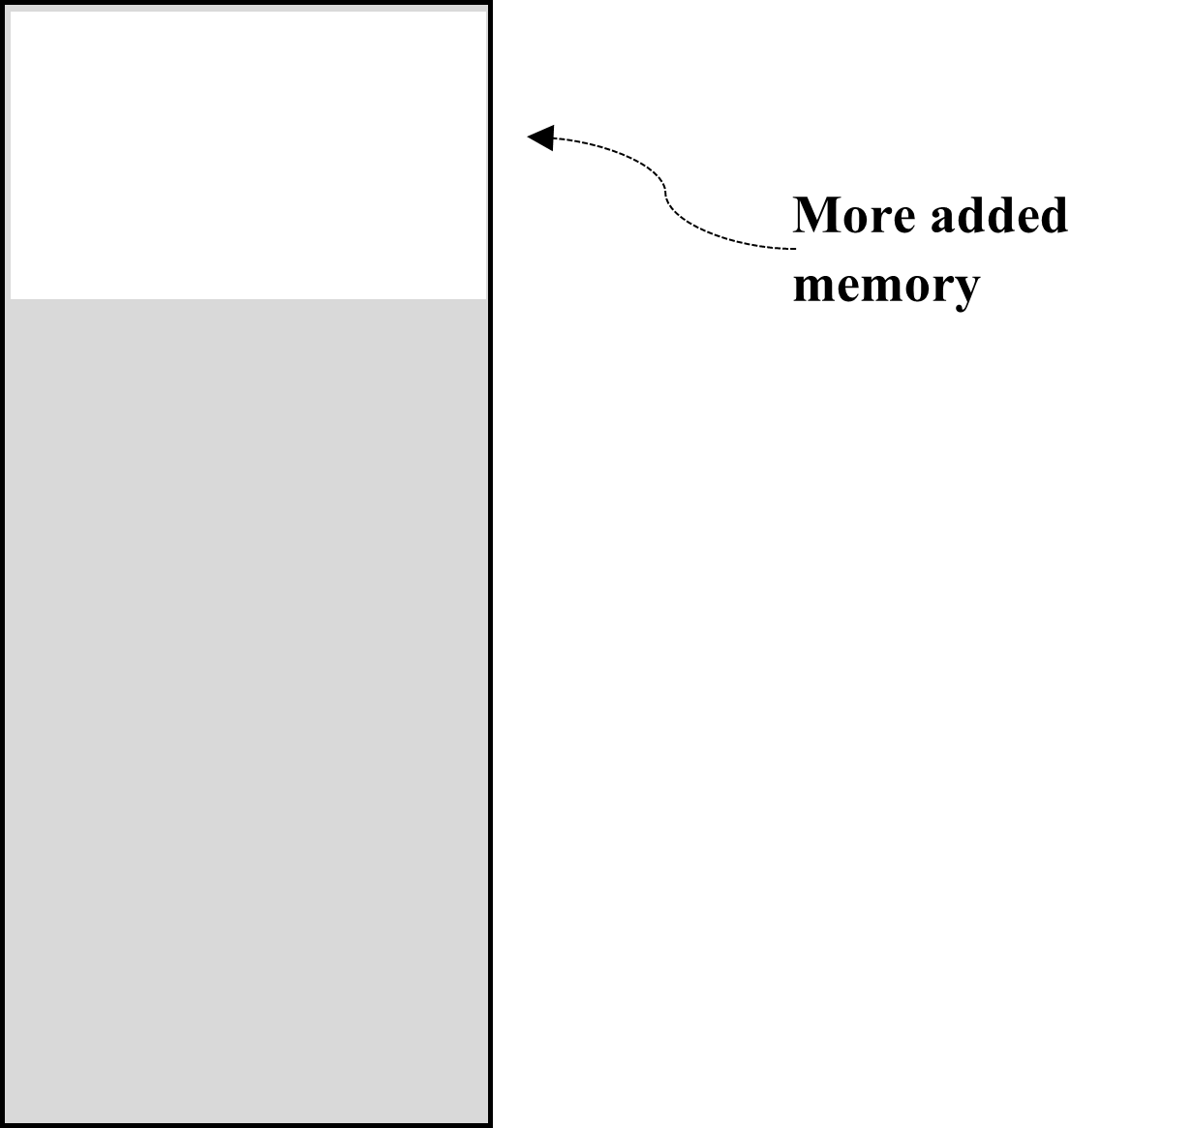
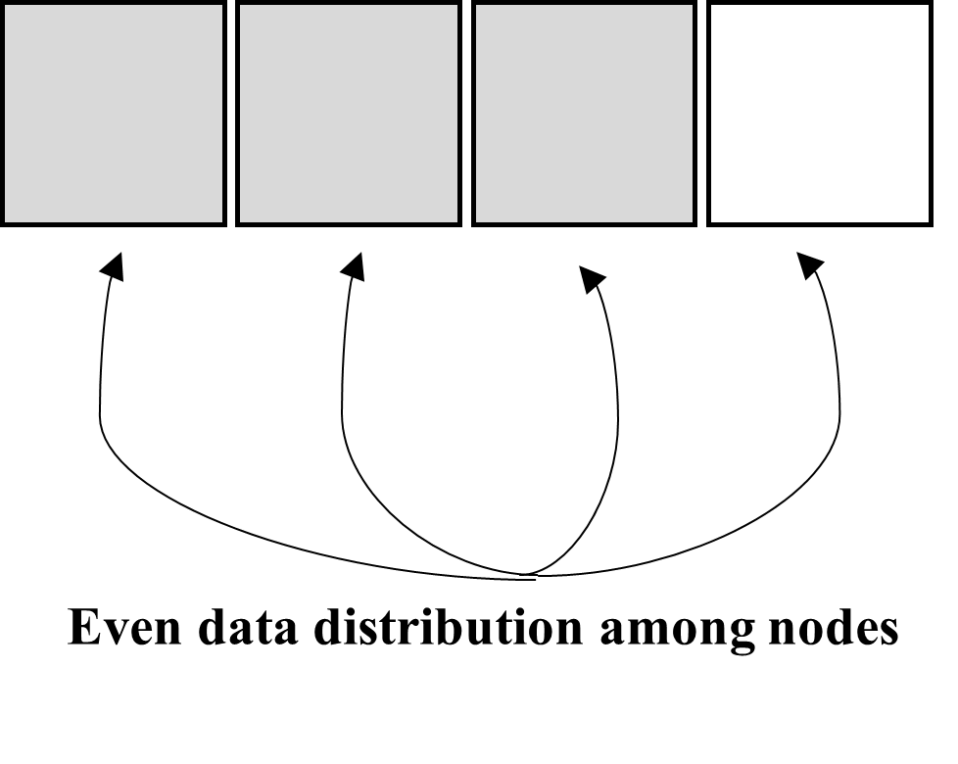
Horizontal Scaling
Vertical Scaling
Notes:
Hori – 2 main layers storage and computation. Storage layer -> data is stored and passed to computational. Apache Hadoop; Storage layer Hadoop Distributed File System, Dataset partioned and distributed over multiple machines, parrallel processing. Data is unlikely to be lost in event of hardware and s/w failres. Simple Algorithm called Mapreduce

Slide 99
Concerns
Amount of data is huge thus; Scalability of ML models gets our attention.
Our model needs to deal with any amount of data with less consumption of resources
Machine Learning workflow can be categorised in to 2 primary routines
Model Training
Model Prediction
IT18034400 | Renu Harshatha A. | 2021-085 10.03.2021

Slide 100
References
[1] nomad. (2021, February 28). Nomad Vs. Kubernetes. Retrieved from nomadproject.io: https://www.nomadproject.io/docs/nomad-vs-kubernetes
[2] I. M. M. A. R. A. H. L. N. S. a. A. A. G. Mohammad Saiful, "Detecting Malicious URLs Using Lexical," in University of New Brunswick, Fredericton, NB, Canada, Fredericton, 2016.
[3] S. S. Vishal A. Kharde, "Sentiment Analysis of Twitter Data: A Survey of Techniques," International Journal of Computer Applications (0975 – 8887), vol. Volume 139, no. 11, p. 15, 2016.
[4] E. B. O. D. B. D. Ozgur Koray Sahingoz, "Machine learning based phishing detection from URLs," Expert Systems With Applications, 2019.
[5] RTE. (2020, August Tuesday). 'Alarming' cybercrime increase during Covid-19 pandemic, says Interpol. Retrieved from RTE: https://www.rte.ie/news/newslens/2020/0804/1157249-cybercrime/
[6] Rob Lefferts. (2020, April 8). Microsoft shares new threat intelligence, security guidance during global crisis. Retrieved from Microsoft : https://www.microsoft.com/security/blog/2020/04/08/microsoft-shares-new-threat-intelligence-security-guidance-during-global-crisis/
[7] expected once withdrawal agreement is finalised: https://www.itpro.co.uk/security/32560/spike-in-brexit-themed-phishing-attacks-expected-once-withdrawal-agreement-is
IT18034400 | Renu Harshatha A. | 2021-085 10.03.2021

Slide 101
Budget
$300 in Azure
Model Training and Testing
Website Deployment
IT18034400 | Renu Harshatha A. | 2021-085 10.03.2021

Slide 102
Commercialization
First Line of Defence for Organisations
Focuses on Remote working
Inexpensive
Targeting Small-to-Medium Enterprises
On-prem/Cloud Deployments
IT18034400 | Renu Harshatha A. | 2021-085 07.07.2021

Slide 103

Pricing Model
Free-trial
Chrome Extension available upto 5 users.
Premium Users
Reporting Dashboard
Administrative controls for the Extension
Pricing Tier wil depend on number of extension purchased
IT18034400 | Renu Harshatha A. | 2021-085 10.03.2021

Slide 104
Thanks!

Slide 105
Event-Driven Malicious Extractor
Initiation
Planning
Design
Implementation
Closeout
Creation of Project Charter
Creation of Project Proposal
Choosing a methodology for scaling the system
Creating a browser extension
Setting up cloud
Wireframes , UI for browser extension
Testing Nomad containerisation with ensemble model
Testing the model’s scalability and accuracy
Testing and Implementing browser extension which also supports mobile devices
Implementing a procedure to Create logs and reports through browser extension
Host the application and run it
Final Presentation
System Design for Scaling the system

